Slide 1
Ethics in Information Technology, Fourth Edition
Chapter 3
Computer and Internet Crime

Slide 2
Objectives
As you read this chapter, consider the following questions:
  What key trade-offs and ethical issues are associated with the safeguarding of data and information systems?
  Why has there been a dramatic increase in the number of computer-related security incidents in recent years?
  What are the most common types of computer security attacks?
Ethics in Information Technology, Fourth Edition

Slide 3
Objectives (cont’d.)
  Who are the primary perpetrators of computer crime, and what are their objectives?
  What are the key elements of a multilayer process for managing security vulnerabilities based on the concept of reasonable assurance?
  What actions must be taken in response to a security incident?
  What is computer forensics, and what role does it play in responding to a computer incident?
Ethics in Information Technology, Fourth Edition

Slide 4
IT Security Incidents: A Major Concern
Security of information technology is of utmost importance
  Safeguard:
    Confidential business data
    Private customer and employee data
  Protect against malicious acts of theft or disruption
  Balance against other business needs and issues
Number of IT-related security incidents is increasing around the world
Ethics in Information Technology, Fourth Edition

Slide 5
Why Computer Incidents Are So Prevalent
Increasing complexity increases vulnerability
  Computing environment is enormously complex
    Continues to increase in complexity
    Number of entry points expands continuously
    Cloud computing and virtualization software
Higher computer user expectations
  Computer help desks under intense pressure
    Forget to verify users’ IDs or check authorizations
Computer users share login IDs and passwords
Ethics in Information Technology, Fourth Edition

Slide 6
Why Computer Incidents Are So Prevalent (cont’d.)
Expanding/changing systems equal new risks
  Network era
    Personal computers connect to networks with millions of other computers
    All capable of sharing information
  Information technology
    Ubiquitous(present, appearing, or found everywhere.)
    Necessary tool for organizations to achieve goals
    Increasingly difficult to match pace of technological change
Ethics in Information Technology, Fourth Edition

Slide 7
Why Computer Incidents Are So Prevalent (cont’d.)
Increased reliance on commercial software with known vulnerabilities
  Exploit
    Attack on information system
    Takes advantage of system vulnerability
    Due to poor system design or implementation
  Patch
    “Fix” to eliminate the problem
    Users are responsible for obtaining and installing
    Delays expose users to security breaches
Ethics in Information Technology, Fourth Edition

Slide 8
Why Computer Incidents Are So Prevalent (cont’d.)
Zero-day attack
A zero day vulnerability refers to a hole in software that is unknown to the vendor. This security hole is then exploited by hackers before the vendor becomes aware and hurries to fix it—this exploit is called a zero day attack. Uses of zero day attacks can include infiltrating malware, spyware or allowing unwanted access to user information. The term “zero day” refers to the unknown nature of the hole to those outside of the hackers, specifically, the developers. Once the vulnerability becomes known, a race begins for the developer, who must protect use
  Before a vulnerability is discovered or fixed
U.S. companies rely on commercial software with known vulnerabilities(the quality or state of being exposed to the possibility of being attacked or harmed, either physically or emotionally)
Ethics in Information Technology, Fourth Edition

Slide 9
Types of Exploits
Computers as well as smartphones can be target
Types of attacks
  Virus
  Worm
  Trojan horse
  Distributed denial of service
  Rootkit
  Spam
  Phishing (spear-phishing, smishing, and vishing)
Ethics in Information Technology, Fourth Edition

Slide 10
Viruses
Pieces of programming code
Usually disguised as something else
Cause unexpected and undesirable behavior
Often attached to files
Deliver a “payload”(infected info)
Spread by actions of the “infected” computer user
    Infected e-mail document attachments
    Downloads of infected programs
    Visits to infected Web sites
Ethics in Information Technology, Fourth Edition

Slide 11
Examples of virus
The Morris worm
In 1998 Robert Morris, a university student, unleashed a worm which affected 10 per cent of all the computers connected to the internet (at the time the net was estimated to consist of 60,000 computers), slowing them down to a halt. Morris is now an associate professor at MIT.
Ethics in Information Technology, Fourth Edition

Slide 12
ILOVEYOU
The Love Bug flooded internet users with ILOVEYOU messages in May 2000, forwarding itself to everybody in the user's address book. It was designed to steal internet access passwords for its Filipino creator
Ethics in Information Technology, Fourth Edition

Slide 13
Storm worm
The Storm worm, originally posing as breaking news of bad weather hitting Europe, infected computers around the world in 2007. Millions of infected PCs were taken over by hackers and used to spread spam and steal identities.
Ethics in Information Technology, Fourth Edition

Slide 14
http://heartbleed.com/
http://indiatoday.intoday.in/education/story/dangerous-virus/1/465130.html
https://en.wikipedia.org/wiki/WannaCry_ransomware_attack
Ethics in Information Technology, Fourth Edition

Slide 15
Worms
Harmful programs
  Reside in active memory of a computer
  Duplicate themselves
Can propagate without human intervention
Negative impact of worm attack
  Lost data and programs
  Lost productivity
  Additional effort for IT workers
Ethics in Information Technology, Fourth Edition

Slide 16
Example of worms
In 2000, the ILOVEYOU worm was spread as an email attachment. Clicking the attachment resulted in an infection, rather than an expression of affection. This infection could overwrite most of the data on the infected computer. Another worm began to spread soon after - Code Red was released in 2001, and it exploited a weakness in a popular Microsoft Web server.
The all-around worst, though, was MSBlast. Spread during 2003, it is said to be the most damaging, malicious software in history. It resulted in the infection of 25 million computers, a nightmare for Microsoft's tech support center (3 million callers within five days of MSBlast's release), and the arrest and imprisonment of at least one person. The one who was imprisoned only wrote a minor variant of it,
Ethics in Information Technology, Fourth Edition

Slide 17
Trojan Horses
Malicious code hidden inside seemingly harmless programs
Users are tricked into installing them
Delivered via email attachment, downloaded from a Web site, or contracted via a removable media device
Logic bomb
  Executes when triggered by certain event
  (example by a change in a particular file, by typing a specific series of keystrokes.)
Ethics in Information Technology, Fourth Edition

Slide 18
Distributed Denial-of-Service (DDoS) Attacks
Malicious hacker takes over computers on the Internet and causes them to flood a target site with demands for data and other small tasks
  The computers that are taken over are called zombies
  Botnet is a very large group of such computers controlled by hackers
Does not involve a break-in at the target computer
  Target machine is busy responding to a stream of automated requests
  users cannot access target machine(example dialing a telephone number repeatedly so that other callers hear a busy signal)
Ethics in Information Technology, Fourth Edition

Slide 19
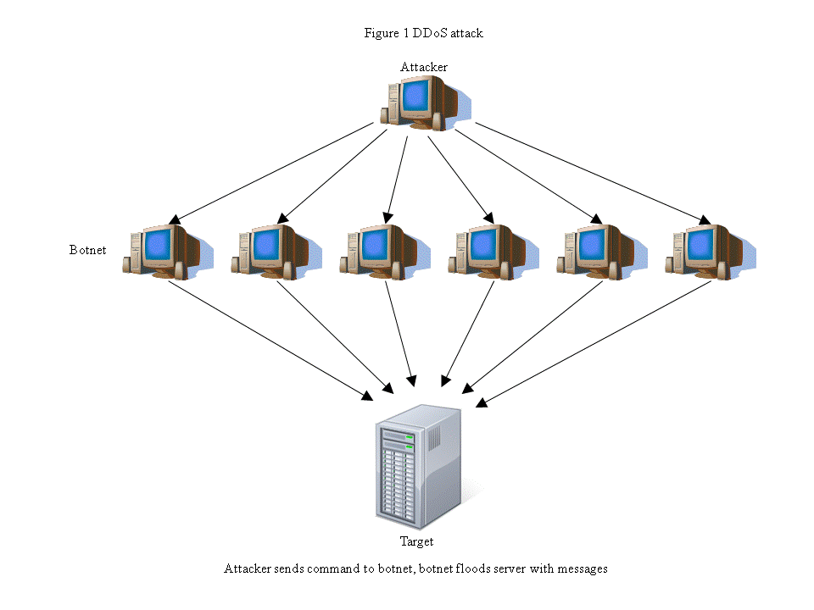
Ethics in Information Technology, Fourth Edition

Slide 20
Rootkits(root access)
Set of programs that enables its user to gain administrator-level access to a computer without the end user’s consent or knowledge
Attacker can gain full control of the system and even obscure the presence of the rootkit
Fundamental problem in detecting a rootkit is that the operating system currently running cannot be trusted to provide valid test results
The rootkits disguise themselves as drivers.
Ethics in Information Technology, Fourth Edition

Slide 21
Spam
Abuse of email systems to send unsolicited email to large numbers of people
  Low-cost commercial advertising for questionable products
  Method of marketing also used by many legitimate organizations
Completely Automated Public Turing Test to Tell Computers and Humans Apart (CAPTCHA)
  Software generates tests that humans can pass but computer programs cannot.
  It consider your IP address /cookie activity and a lot more system information.
  They record the movement of the mouse perform clicking on the I m a robot button.
Ethics in Information Technology, Fourth Edition

Slide 22
Phishing
Act of using email fraudulently to try to get the recipient to reveal personal data
Legitimate-looking emails lead users to counterfeit Web sites
Spear-phishing
  Fraudulent emails to an organization’s employees
Smishing
  Phishing via text messages
Vishing
  Phishing via voice mail messages
Ethics in Information Technology, Fourth Edition

Slide 23
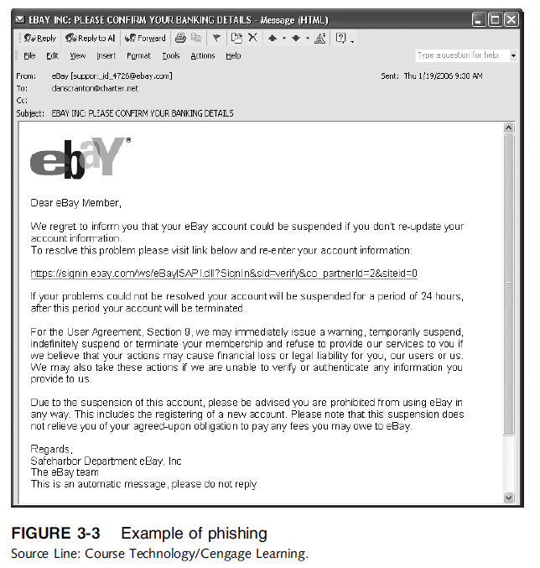
Ethics in Information Technology, Fourth Edition

Slide 24
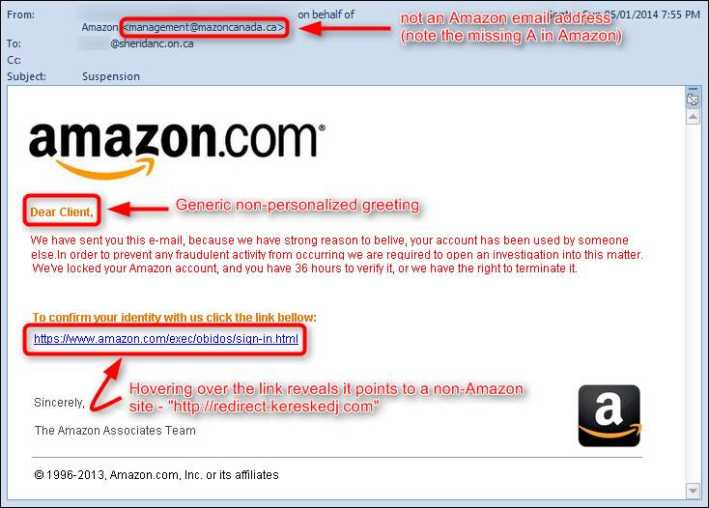
Ethics in Information Technology, Fourth Edition

Slide 25
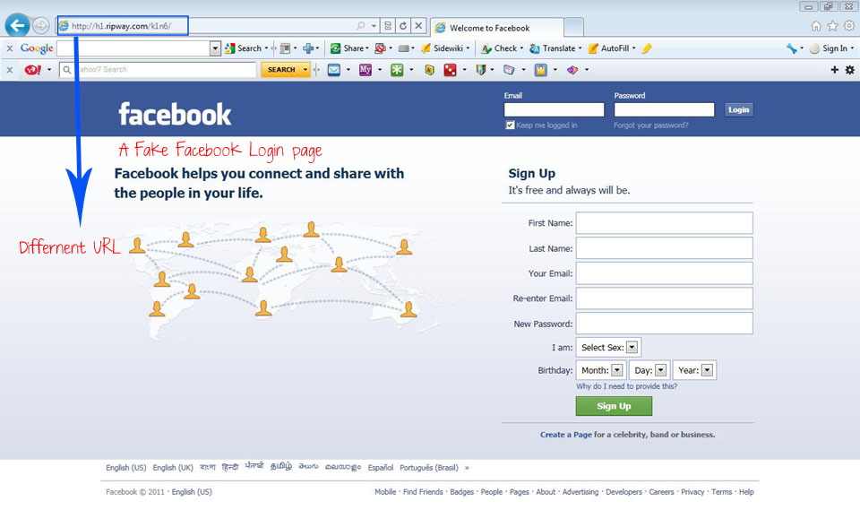
Ethics in Information Technology, Fourth Edition

Slide 26
Types of Perpetrators(a person who carries out a harmful, illegal, or immoral act.)
Perpetrators include:
  Thrill seekers wanting a challenge
  Common criminals looking for financial gain
  Industrial spies trying to gain an advantage
  Terrorists seeking to cause destruction
Different objectives and access to varying resources
Willing to take different levels of risk to accomplish an objective
Ethics in Information Technology, Fourth Edition

Slide 27
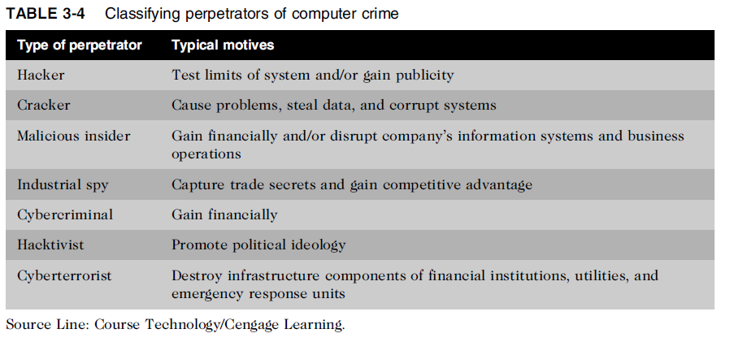
Types of Perpetrators (cont’d.)
Ethics in Information Technology, Fourth Edition

Slide 28
Hackers and Crackers
Hackers
  Test limitations of systems out of intellectual curiosity
    Some smart and talented
    termed “lamers” or “script kiddies”
Crackers
  Cracking is a form of hacking
  Clearly criminal activity
Ethics in Information Technology, Fourth Edition

Slide 29
DEF CON (also written as DEFCON, Defcon, or DC) is one of the world's largest annual hacking conferencehacker con.
Ethics in Information Technology, Fourth Edition

Slide 30
Malicious Insiders
Major security concern for companies
Fraud within an organization is usually due to weaknesses in internal control procedures
Collusion
  Cooperation between an employee and an outsider
Insiders are not necessarily employees
  Can also be consultants and contractors
Extremely difficult to detect or stop
  Authorized to access the very systems they abuse
Negligent insiders have potential to cause damage
Ethics in Information Technology, Fourth Edition

Slide 31
Industrial Spies
Use illegal means to obtain trade secrets from competitors
Trade secrets are protected by the Economic Espionage Act of 1996
Competitive intelligence
  Uses legal techniques
  Gathers information available to the public
Industrial espionage
  Uses illegal means
  Obtains information not available to the public
Ethics in Information Technology, Fourth Edition

Slide 32
Cybercriminals
Hack into corporate computers to steal
Engage in all forms of computer fraud
Chargebacks are disputed transactions
Example transferring money from one account to another
Loss of customer trust has more impact than fraud
To reduce potential for online credit card fraud:
  Use encryption technology
  Verify the address submitted online against the issuing bank
  Use transaction-risk scoring software
Ethics in Information Technology, Fourth Edition

Slide 33
Cybercriminals (cont’d.)
Smart cards
  Contain a memory chip
  Updated with encrypted data each time card is used
  Used widely in Europe
  Not widely used in the U.S.
Ethics in Information Technology, Fourth Edition

Slide 34
Hacktivists and Cyberterrorists
Hacktivism
  Hacking to achieve a political or social goal
Cyberterrorist
  Attacks computers or networks in an attempt to intimidate a government in order to advance certain political or social objectives
  Seeks to cause harm rather than gather information
  Uses techniques that destroy or disrupt services
Ethics in Information Technology, Fourth Edition

Slide 35
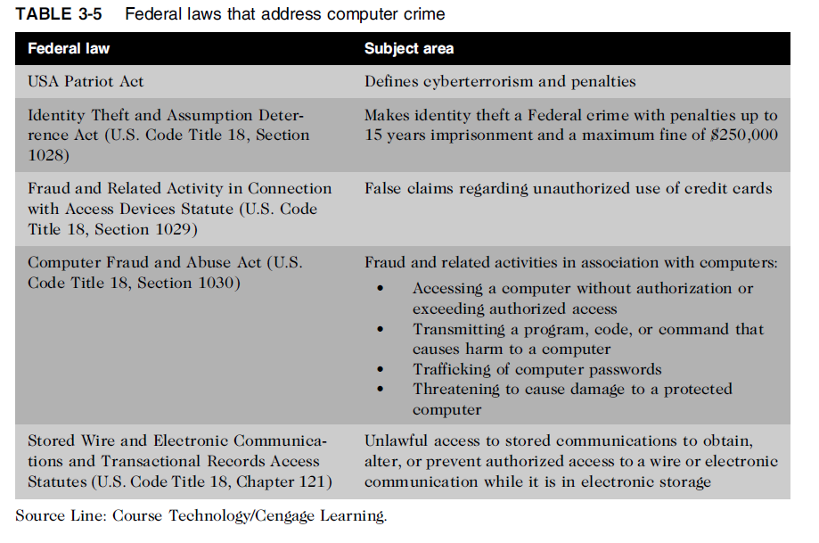
Federal Laws for Prosecuting Computer Attacks
Ethics in Information Technology, Fourth Edition

Slide 36
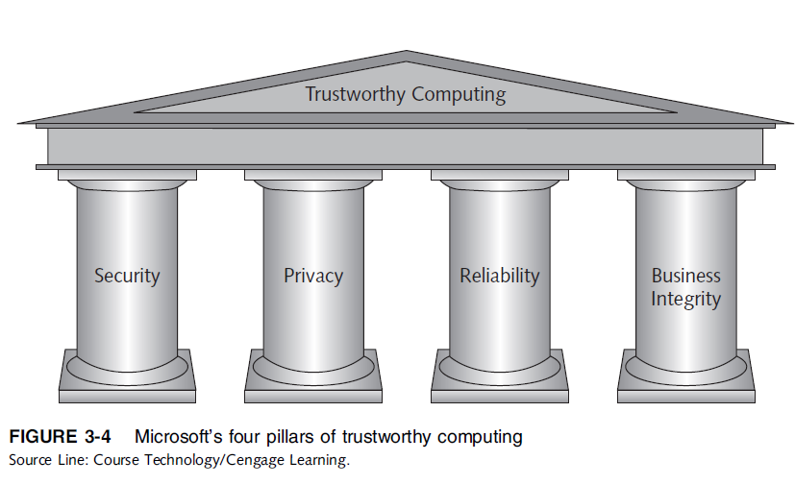
Implementing Trustworthy Computing
Trustworthy computing
  Delivers secure, private, and reliable computing
  Based on sound business practices
Ethics in Information Technology, Fourth Edition

Slide 37
Implementing Trustworthy Computing (cont’d.)
Security of any system or network
  Combination of technology, policy, and people
  Requires a wide range of activities to be effective
Systems must be monitored to detect possible intrusion
Clear reaction plan addresses:
  Notification, evidence protection, activity log maintenance, containment, eradication, and recovery
Ethics in Information Technology, Fourth Edition

Slide 38
Security:-the protection of information systems against unauthorized access to or modification of information, whether in storage, processing or transit, and against the denial of service to authorized users or the provision of service to unauthorized users, including those measure necessary to detect, document, and counter such threats.
Privacy:-the quality or state of being apart from company or observation b) freedom from unauthorized intrusion.
Reliability- the extent to which an experiment, test, or measuring procedure yields the same results on repeated trials. Relaibiltiy in the content of Trustworthy Computing is presented by Microsoft as more then just reliable software and provding support. Microsoft believes it means being a reliable business partner, maintaining an open dialogue with our customers and industry partners, and seeking feedback about how we can improve our software and services.
Integrity- the quality or state of being complete or undivided.
A company must display and earn the trust with the client. Trust is assured reliance on the character, ability, strength, of a business . · Character feedback and opinions from clients and team members will display leadership and open up ideas for improvement
Ethics in Information Technology, Fourth Edition

Slide 39
MCQ
A(n) ____ takes place before the security community or software developer knows about the vulnerability or has been able to repair it.
a. Zero-day attack
b. Hacking
c. Spying
d. System testing.
Technically inept hackers are referred to as ___
a. Script kiddies
b. Lamers
c. None of the above
d. Both a & b
Ethics in Information Technology, Fourth Edition

Slide 40
Which of the following is not the type of exploits?
a. Worms
b. Virus
c. Spam
d. firewall
_____ is a piece of code that causes a computer to behave in an unexpected and usually undesirable manner.
a. Worms
b. Trojan Horses
c. Viruses
d. DDoS Attacks
Ethics in Information Technology, Fourth Edition

Slide 41
Questions
Types of exploits
Four pillars of trustworthy computing
Types of Perpetrators
Ethics in Information Technology, Fourth Edition

Slide 42
Risk Assessment
Process of assessing security-related risks:
  To an organization’s computers and networks
  From both internal and external threats
Identifies which investments of time and resources will best protect from most likely and serious threats
Focuses security efforts on areas of highest payoff
An asset is any hardware or software,network,database that is used by org. to achieve its business objectives
Ethics in Information Technology, Fourth Edition

Slide 43
Risk Assessment (cont’d.)
Eight-step risk assessment process
  #1 Identify assets of most concern
  #2 Identify loss events that could occur
  #3 Assess likelihood of each potential threat
  #4 Determine the impact of each threat
  #5 Determine how each threat could be mitigated
  #6 Assess feasibility of mitigation options
  #7 Perform cost-benefit analysis
  #8 Decide which countermeasures to implement
Ethics in Information Technology, Fourth Edition

Slide 44
Step 1:- assets that supports the org mission and the meeting of its primary goals.
Step 2:- Identify the loss events or risks that could occur such as Ddos attack.
Step 3:-Asses the frequency of threats example insider fraud are more likely to occur than others
Step 4:- determine the impact of each threat occurring. Would it have a minor impact or major impact.
Step 5:-determine how each threat can be mitigated(action of reducing the seriousness) so that it becomes much less likely to occur example antivirus.
Step 6:- Feasibility(the state or degree of being easily or conveniently done.)of implementing the mitigation(act of reducing seriousness) options
Ethics in Information Technology, Fourth Edition

Slide 45
Step 7:- Perform a cost benefit analysis to ensure that your efforts will be cost effective.
The concept of reasonable assurance recognizes that managers must use their judgement to ensure that the cost of control does not exceed the system’s benefit risk or risk involved.
Step 8:- Make decision on whether or not to implement a particular countermeasure. If you decide against implementing a particular countermeasure,you need to reassess if the threat is truly serious, if so identify a less costly counter measure
Ethics in Information Technology, Fourth Edition

Slide 46
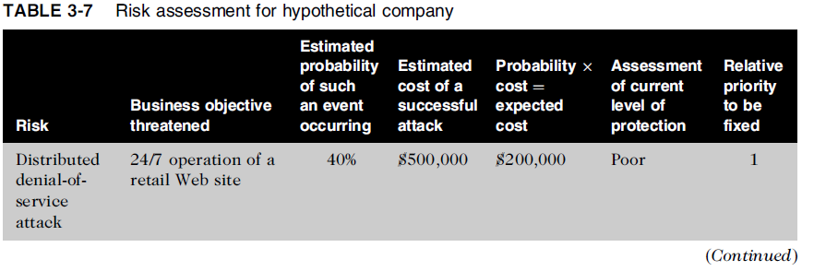
Risk Assessment (cont’d.)
Ethics in Information Technology, Fourth Edition

Slide 47
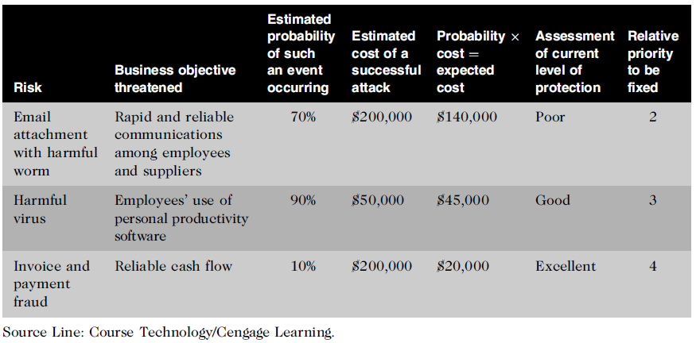
Risk Assessment (cont’d.)
Ethics in Information Technology, Fourth Edition

Slide 48
Establishing a Security Policy
A security policy defines:
  Organization’s security requirements
  Controls and sanctions needed to meet the requirements
Describe responsibilities and expected behavior
Outlines what needs to be done
  Not how to do it
Automated system policies should mirror written policies
Ethics in Information Technology, Fourth Edition

Slide 49
Establishing a Security Policy (cont’d.)
Trade-off (compromise)between:
  Ease of use
  Increased security
Areas of concern
  Email attachments(block an email with attachment)
  Wireless devices
VPN(virtual private network) uses the Internet to relay communications but maintains privacy through security features
Additional security includes encrypting originating and receiving network addresses
Ethics in Information Technology, Fourth Edition

Slide 50
Educating Employees, Contractors, and Part-Time Workers
Educate and motivate users to understand and follow policy
Discuss recent security incidents
Help protect information systems by:
  Guarding passwords
  Not allowing sharing of passwords
  Applying strict access controls to protect data
  Reporting all unusual activity
  Protecting portable computing and data storage devices
Ethics in Information Technology, Fourth Edition

Slide 51
Prevention
Implement a layered security solution
  Make computer break-ins harder
  If any attacker breaks one layers their will be another layer to protect it.
Installing a corporate firewall
  Limits network access
Intrusion prevention systems
  Block viruses, malformed packets, and other threats
Installing antivirus software
  Scans for sequence of bytes or virus signature
  United States Computer Emergency Readiness Team (US-CERT) serves as clearinghouse to protect internet infrastructure from cyber attack
Ethics in Information Technology, Fourth Edition

Slide 52
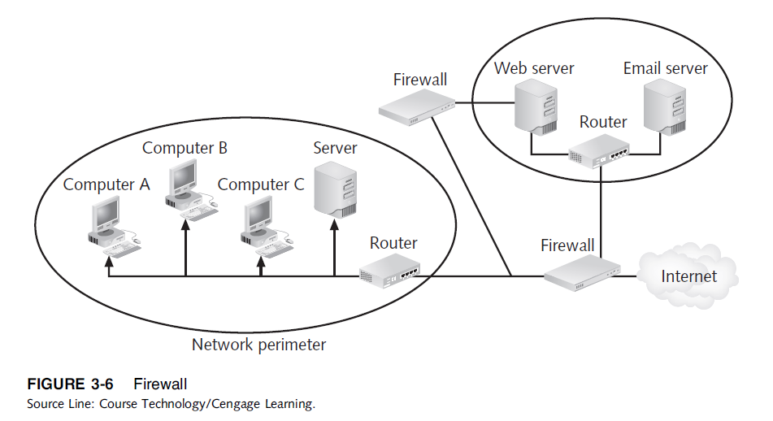
Prevention (cont’d.)
Ethics in Information Technology, Fourth Edition

Slide 53
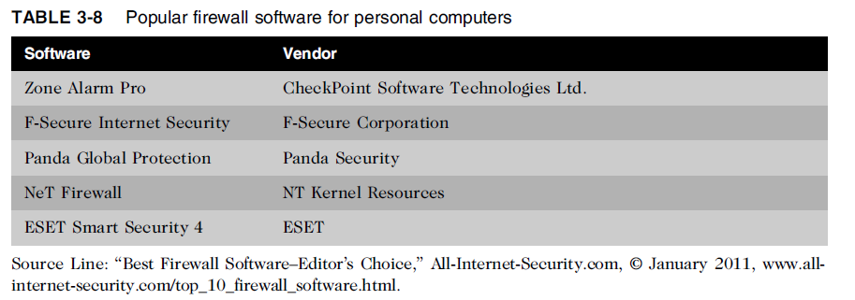
Prevention (cont’d.)
Ethics in Information Technology, Fourth Edition

Slide 54
Prevention (cont’d.)
Safeguards against attacks by malicious insiders
Departing employees and contractors
  Promptly delete computer accounts, login IDs, and passwords
Carefully define employee roles and separate key responsibilities
Create roles and user accounts to limit authority
Ethics in Information Technology, Fourth Edition

Slide 55
Prevention (cont’d.)
Defending against cyberterrorism
  Department of Homeland Security and its National Cyber Security Division (NCSD) is a resource
    Builds and maintains a national security cyberspace response system
    Implements a cyber-risk management program for protection of critical infrastructure, including banking and finance, water, government operations, and emergency services
Ethics in Information Technology, Fourth Edition

Slide 56
Prevention (cont’d.)
Conduct periodic IT security audits
  Evaluate policies and whether they are followed
  Review access and levels of authority
  Test system safeguards
  Information Protection Assessment kit is available from the Computer Security Institute
Ethics in Information Technology, Fourth Edition

Slide 57
Detection
Detection systems
  Catch intruders in the act
Intrusion detection system
  Monitors system/network resources and activities
  Notifies the proper authority when it identifies:
    Possible intrusions from outside the organization
    Misuse from within the organization
  Knowledge-based approach
  Contains information about specific attack
  Behavior-based approach
  Any change in the behavior when compared with original model.
Ethics in Information Technology, Fourth Edition

Slide 58
Response
Response plan
  Develop well in advance of any incident
  Approved by:
    Legal department
    Senior management
Primary goals
  Regain control and limit damage
  Not to monitor or catch an intruder
Ethics in Information Technology, Fourth Edition

Slide 59
Response (cont’d.)
Incident notification defines:
  Who to notify
  Who not to notify
Security experts recommend against releasing specific information about a security compromise in public forums, conference or seminar.( it should be shared with other groups but not through corrupted system))
Document all details of a security incident
  All system events
  Specific actions taken
  All external conversations
Ethics in Information Technology, Fourth Edition

Slide 60
Response (cont’d.)
Act quickly to contain an attack
Eradication effort(the complete destruction of something.)
  Collect and log all possible criminal evidence
  Verify necessary backups are current and complete
  Create new backups
Follow-up
  Determine how security was compromised
    Prevent it from happening again
Ethics in Information Technology, Fourth Edition

Slide 61
Response (cont’d.)
Review
  Determine exactly what happened
  Evaluate how the organization responded
Weigh carefully the amount of effort required to capture the perpetrator
Consider the potential for negative publicity
Ethics in Information Technology, Fourth Edition

Slide 62
Computer Forensics
Combines elements of law and computer science to identify, collect, examine, and preserve data and preserve its integrity so it is admissible as evidence
Computer forensics investigation requires extensive training and certification and knowledge of laws that apply to gathering of criminal evidence
Ethics in Information Technology, Fourth Edition

Slide 63
http://tips4pc.com/computer_tips_and_tricks/6-juicy-criminal-cases-that-used-computer-forensics.htm
http://forensicswiki.org/wiki/Famous_Cases_Involving_Digital_Forensics
Ethics in Information Technology, Fourth Edition

Slide 64
Summary
Ethical decisions in determining which information systems and data most need protection
Most common computer exploits
  Viruses
  Worms
  Trojan horses
  Distributed denial-of-service attacks
  Rootkits
  Spam
  Phishing, spear-fishing, smishing, vishing
Ethics in Information Technology, Fourth Edition

Slide 65
Summary (cont’d.)
Perpetrators include:
  Hackers
  Crackers
  Malicious insider
  Industrial spies
  Cybercriminals
  Hacktivist
  Cyberterrorists
Ethics in Information Technology, Fourth Edition

Slide 66
Summary (cont’d.)
Must implement multilayer process for managing security vulnerabilities, including:
  Assessment of threats
  Identifying actions to address vulnerabilities
  User education
IT must lead the effort to implement:
  Security policies and procedures
  Hardware and software to prevent security breaches
Computer forensics is key to fighting computer crime in a court of law
Ethics in Information Technology, Fourth Edition

Slide 67
Mcq
Pillars of trustworthy computing
a. Security, Privacy, Reliability, Business Integrity
b. Security, Protection, Reliability, Business Integrity
c. Speed, Protection, Reliability, Business Integrity
d. Safety, Privacy, Reliability, Business Integrity
_____ is the one in which organization receive fraudulent emails
a. Spear -Phishing
b. Smishing
c. Vishing
d. Phishing
Ethics in Information Technology, Fourth Edition

Slide 68
Which among following is not the vendor of firewall
a. F-Secure Corporation
b. NiT kernel Resources
c. Panda Security
d. Check Point Software Technologies ltd.
IPS stands for
a. Intrusion Protection System
b. Internet Prevention System
c. Intrusion Precaution System
d. Intrusion Prevention System
Ethics in Information Technology, Fourth Edition

Slide 69
Template defines the means to establish a culture of openness, trust, and integrity in business practices.
a. Information Sensitivity Policy
b. Ethics Policy
c. Risk Assessment Policy
d. Voicemail Policy
Ethics in Information Technology, Fourth Edition

